Slide 1


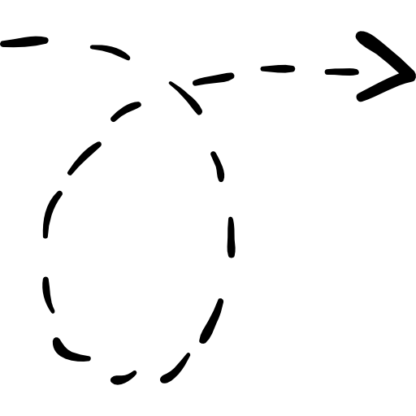
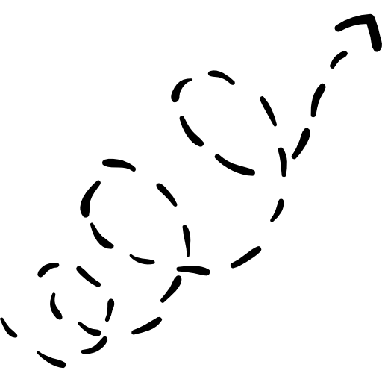
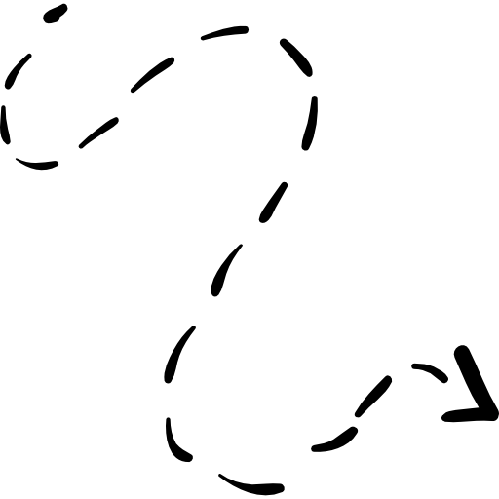

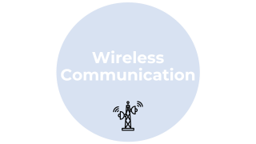







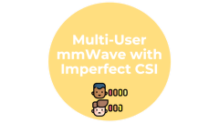

Intelligent and Resilient Resource Allocation in mmWave Wireless Communications
Ahmad Ghasemi
Advisor: Prof. Seyed (Reza) Zekavat
Committee:
Prof. Randy Paffenroth
Prof. Fabricio Murai Prof. Alexander Wyglinski
Prof. Ahmed Alkhateeb
mmWave
Base Station

Slide 2


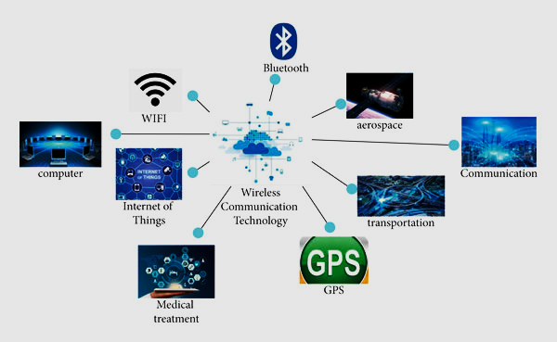
Wireless Communication

Slide 3
Wireless Communication

Slide 4
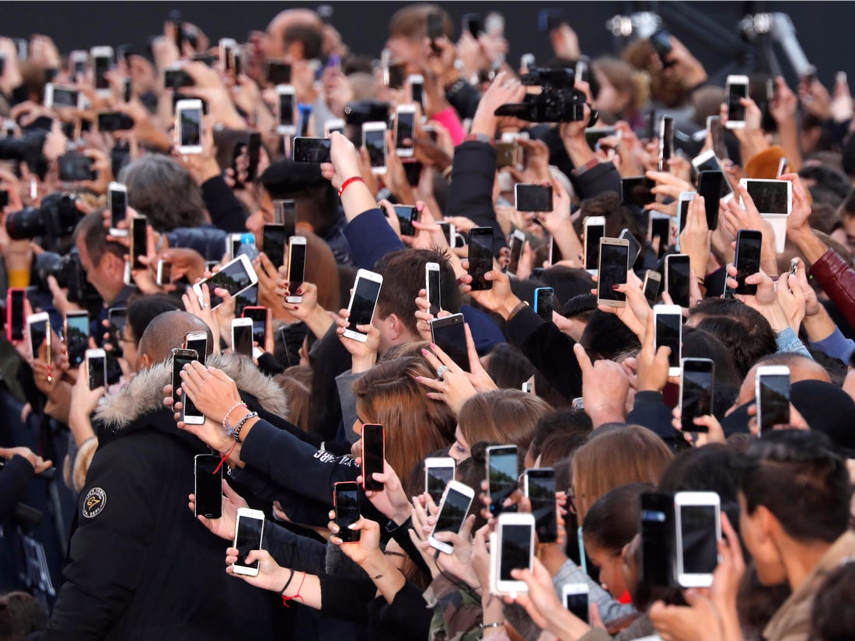





Wireless Generations
>1 Tbps
Network Capacity
20 Gbps
3 THz
1 Gbps
30 Mbps
1 GHz
200 kbps
10 THz
20 MHz
2.4 kbps
300 GHz
5 MHz
Throughput (Speed of Transmission)
200 kHz
2690 MHz
30 kHz
Bandwidth
2170 MHz
960 MHz
894 MHz
Frequency
1G
2G
3G
4G
5G
B5G/6G
1980
1990
2000
2010
2020
2025-2030

Slide 5


Wireless Generations
Omnidirectional
Antenna
Interference
Throughput
Directional
Transmission
Antenna Array
Array Size

Slide 6
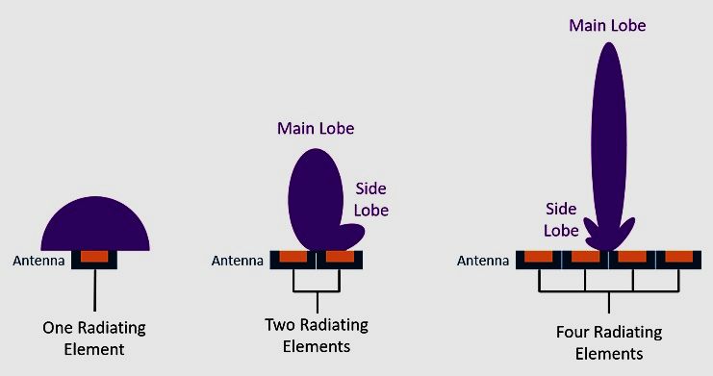
Wireless Generations
# Antenna/Space
frequency
Wavelength
Antenna Size
Narrower Beams

Slide 7
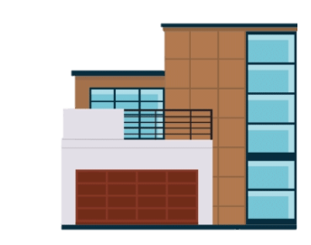
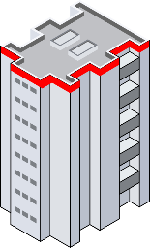
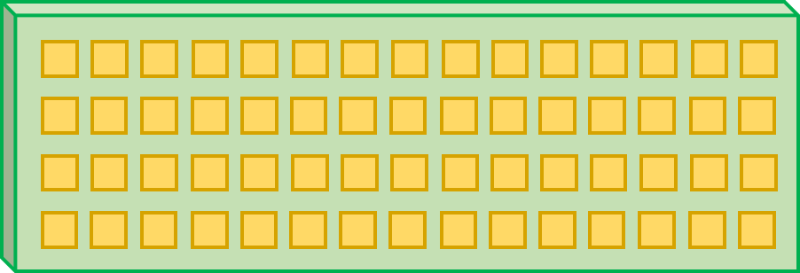

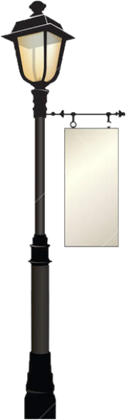




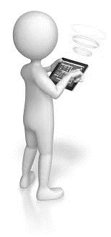




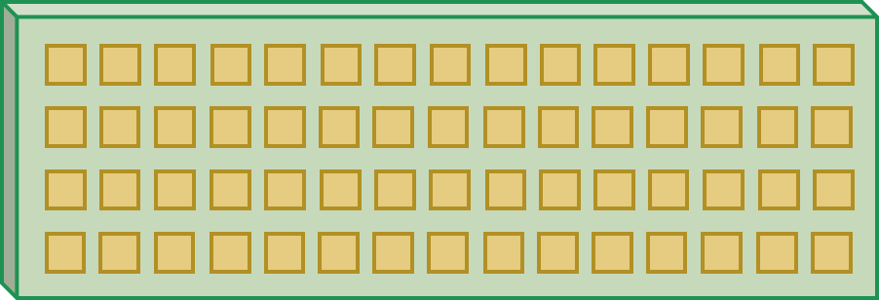

Wireless Generations

Slide 8


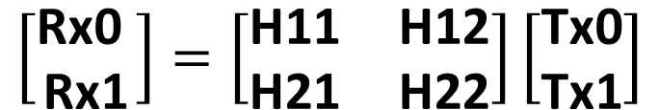
mmWave MIMO Multi-Streaming
Tx0
Rx0
Transmitter
Receiver
Tx1
Rx1
$$\left[\begin{matrix}\text{Rx}\text{0 } \\ \text{Rx}\text{1}\end{matrix}\right]=\left[\begin{matrix}\text{H}\text{1}\text{1} & \text{H}\text{12} \\ \text{H}\text{2}\text{1} & \text{H}\text{22}\end{matrix}\right]\left[\begin{matrix}\text{Tx}\text{0} \\ \text{Tx}\text{1}\end{matrix}\right]$$

Slide 9
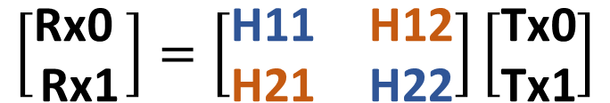
mmWave MIMO Multi-Streaming
Tx0
Rx0
Transmitter
Receiver
Tx1
Rx1
$$\left[\begin{matrix}\text{Rx}\text{0 } \\ \text{Rx}\text{1}\end{matrix}\right]=\left[\begin{matrix}\text{H}\text{1}\text{1} & \text{H}\text{12} \\ \text{H}\text{2}\text{1} & \text{H}\text{22}\end{matrix}\right]\left[\begin{matrix}\text{Tx}\text{0} \\ \text{Tx}\text{1}\end{matrix}\right]$$
Beamforming: control phase and amplitude

Slide 10
Beamforming Types
RF chain
Digital BF
Tx0
RF chain
RF chain
High Power Usage
Transmitter
RF chain
RF chain
Tx1
RF chain
RF chain
RF chain
Tx0
Analog BF
Transmitter
RF chain
One data stream
Tx1
RF chain
Hybrid BF
Tx0
RF chain
Lower Power Usage
Several data streams
Transmitter
RF chain
Tx1
RF chain

Slide 11
TX and Single Antenna Users [1] - [3]
Problem: No BF design @ RX, and Single DS
TX and Multi-Antenna Users [4], [5]
Problem: No BF design and no Dynamic Antenna Clustering @ RX
Our Work: Dynamic Antenna Allocation, and BF design @ TX & RX
[1] G. R. MacCartney, et al., “Millimeter wave wireless communications: New results for rural connectivity,” 5th Workshop All Things Cellular, Oct. 2016.
[2] C. Peng, et al., “Utilization and fairness in spectrum assignment for opportunistic spectrum access,” ACM/Springer Mobile Netw. Appl., Aug. 2006.
[3] S. R. Zekavat and R. M. Buehrer, Handbook of Position Location: Theory, Practice, and Advances, 2nd ed. Hoboken, NJ, USA: Wiley, 2019.
[4] F. Rusek, et al., “Scaling up MIMO: Opportunities and challenges with very large arrays,” IEEE Signal Process. Mag., vol. 30, no. 1, pp. 40–60, Jan. 2013.
[5] S. Park, et al., “Dynamic subarrays for hybrid precoding in wideband mmWave MIMO systems,” IEEE Trans. Wireless Commun., May 2017.

Slide 12
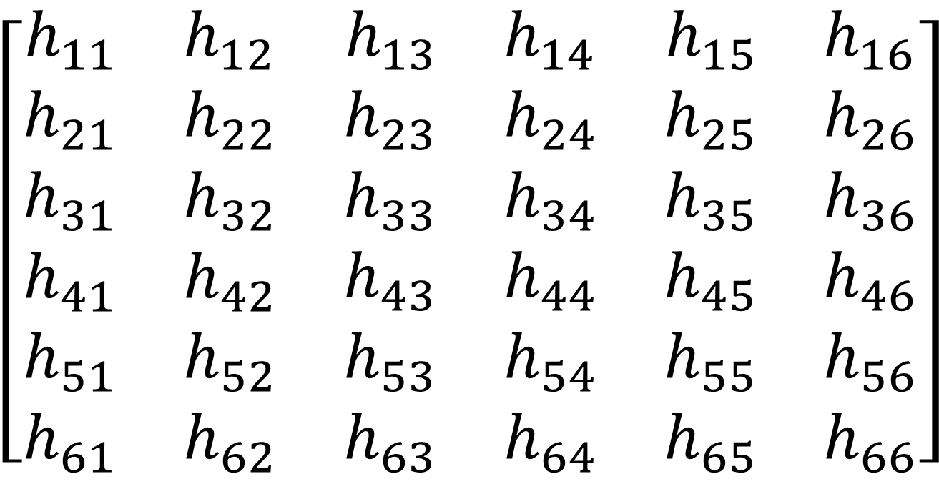
Transmitter Antennas
$$\left[\begin{matrix}\begin{matrix}\begin{matrix}h_{11} & h_{12}\end{matrix} \\ \begin{matrix}h_{21} & h_{22}\end{matrix}\end{matrix} & \begin{matrix}\begin{matrix}h_{13} & h_{14}\end{matrix} \\ \begin{matrix}h_{23} & h_{24}\end{matrix}\end{matrix} & \begin{matrix}\begin{matrix}h_{15} & h_{16}\end{matrix} \\ \begin{matrix}h_{25} & h_{26}\end{matrix}\end{matrix} \\ \begin{matrix}\begin{matrix}h_{31} & h_{32}\end{matrix} \\ \begin{matrix}h_{41} & h_{42}\end{matrix}\end{matrix} & \begin{matrix}\begin{matrix}h_{33} & h_{34}\end{matrix} \\ \begin{matrix}h_{43} & h_{44}\end{matrix}\end{matrix} & \begin{matrix}\begin{matrix}h_{35} & h_{36}\end{matrix} \\ \begin{matrix}h_{45} & h_{46}\end{matrix}\end{matrix} \\ \begin{matrix}\begin{matrix}h_{51} & h_{52}\end{matrix} \\ \begin{matrix}h_{61} & h_{62}\end{matrix}\end{matrix} & \begin{matrix}\begin{matrix}h_{53} & h_{54}\end{matrix} \\ \begin{matrix}h_{63} & h_{64}\end{matrix}\end{matrix} & \begin{matrix}\begin{matrix}h_{55} & h_{56}\end{matrix} \\ \begin{matrix}h_{65} & h_{66}\end{matrix}\end{matrix}\end{matrix}\right]$$
Correlation
1
2
3
Receiver Antennas
5
4
6
Bi-partite Graph
1
2
3
5
Spectral CoClustering (SCC) [1] Spectral BiClustering (SBC) [2]
6
4
[1] Dhillon, I. S. ”Co-clustering documents and words using bipartite spectral graph partitioning.” In Proceedings of the seventh ACM SIGKDD international conference on Knowledge discovery
and data miningACM. August, 2001.
[2] Kluger, Yuval, et. al., 2003. Spectral biclustering of microarray data: coclustering genes and conditions

Slide 13
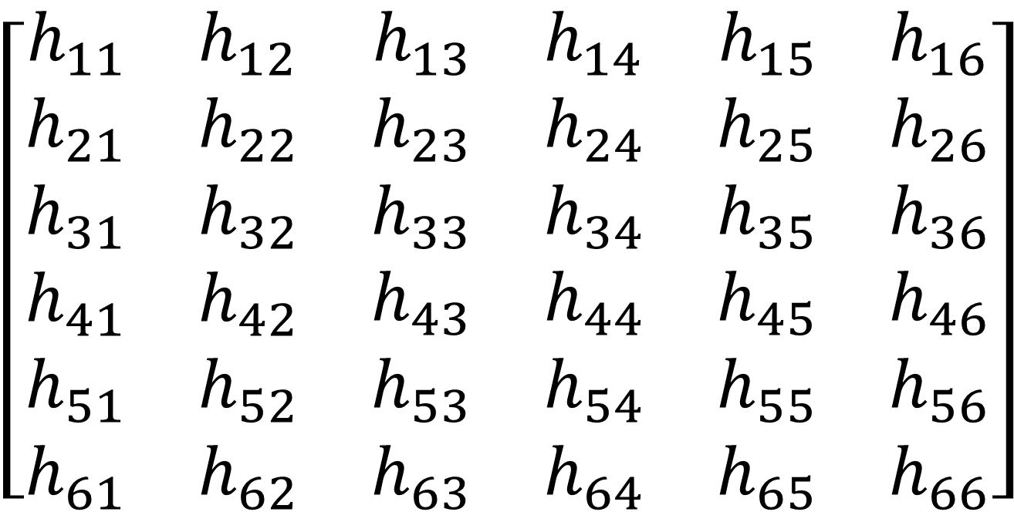
Transmitter Antennas
Spectral CoClustering (SCC)
$$\left[\begin{matrix}\begin{matrix}\begin{matrix}h_{11} & h_{12}\end{matrix} \\ \begin{matrix}h_{21} & h_{22}\end{matrix}\end{matrix} & \begin{matrix}\begin{matrix}h_{13} & h_{14}\end{matrix} \\ \begin{matrix}h_{23} & h_{24}\end{matrix}\end{matrix} & \begin{matrix}\begin{matrix}h_{15} & h_{16}\end{matrix} \\ \begin{matrix}h_{25} & h_{26}\end{matrix}\end{matrix} \\ \begin{matrix}\begin{matrix}h_{31} & h_{32}\end{matrix} \\ \begin{matrix}h_{41} & h_{42}\end{matrix}\end{matrix} & \begin{matrix}\begin{matrix}h_{33} & h_{34}\end{matrix} \\ \begin{matrix}h_{43} & h_{44}\end{matrix}\end{matrix} & \begin{matrix}\begin{matrix}h_{35} & h_{36}\end{matrix} \\ \begin{matrix}h_{45} & h_{46}\end{matrix}\end{matrix} \\ \begin{matrix}\begin{matrix}h_{51} & h_{52}\end{matrix} \\ \begin{matrix}h_{61} & h_{62}\end{matrix}\end{matrix} & \begin{matrix}\begin{matrix}h_{53} & h_{54}\end{matrix} \\ \begin{matrix}h_{63} & h_{64}\end{matrix}\end{matrix} & \begin{matrix}\begin{matrix}h_{55} & h_{56}\end{matrix} \\ \begin{matrix}h_{65} & h_{66}\end{matrix}\end{matrix}\end{matrix}\right]$$
1
2
3
Receiver Antennas
5
4
6
1
2
3
5
Sub-channels
4
6

Slide 14
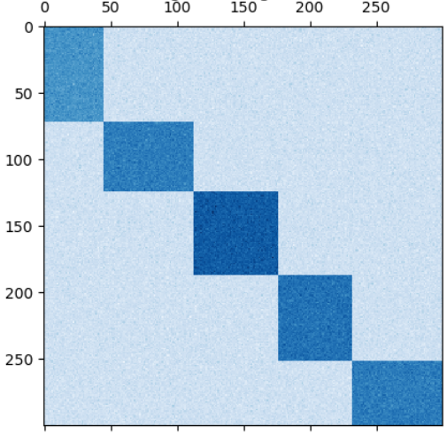
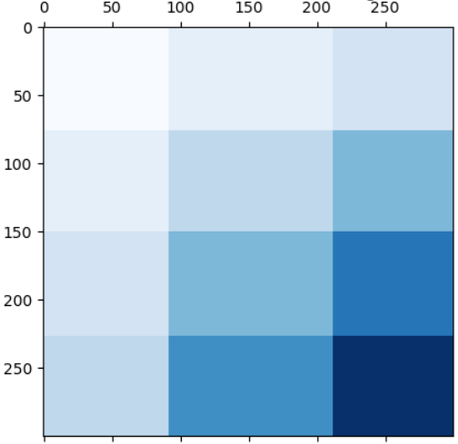
Transmitter Antennas
$$\left[\begin{matrix}\begin{matrix}\begin{matrix}h_{11} & h_{12}\end{matrix} \\ \begin{matrix}h_{21} & h_{22}\end{matrix}\end{matrix} & \begin{matrix}\begin{matrix}h_{13} & h_{14}\end{matrix} \\ \begin{matrix}h_{23} & h_{24}\end{matrix}\end{matrix} & \begin{matrix}\begin{matrix}h_{15} & h_{16}\end{matrix} \\ \begin{matrix}h_{25} & h_{26}\end{matrix}\end{matrix} \\ \begin{matrix}\begin{matrix}h_{31} & h_{32}\end{matrix} \\ \begin{matrix}h_{41} & h_{42}\end{matrix}\end{matrix} & \begin{matrix}\begin{matrix}h_{33} & h_{34}\end{matrix} \\ \begin{matrix}h_{43} & h_{44}\end{matrix}\end{matrix} & \begin{matrix}\begin{matrix}h_{35} & h_{36}\end{matrix} \\ \begin{matrix}h_{45} & h_{46}\end{matrix}\end{matrix} \\ \begin{matrix}\begin{matrix}h_{51} & h_{52}\end{matrix} \\ \begin{matrix}h_{61} & h_{62}\end{matrix}\end{matrix} & \begin{matrix}\begin{matrix}h_{53} & h_{54}\end{matrix} \\ \begin{matrix}h_{63} & h_{64}\end{matrix}\end{matrix} & \begin{matrix}\begin{matrix}h_{55} & h_{56}\end{matrix} \\ \begin{matrix}h_{65} & h_{66}\end{matrix}\end{matrix}\end{matrix}\right]$$
Graph Coloring
1
2
3
Receiver Antennas
5
4
6
1
2
3
5
Spectral BiClustering (SBC)
4
6

Slide 15
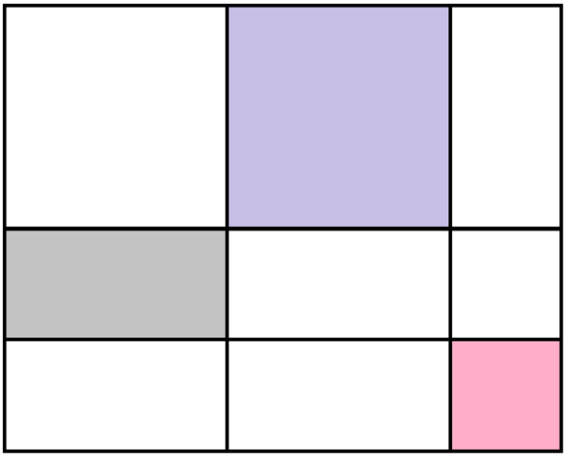


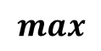
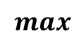

Graph Coloring
Define labels for subchannels as a function of subchannel elements
Select the subchannel with the highest label value
$$max$$
Remove subchannels sharing the same corresponding rows or columns
$$⋯$$
Update the labels of the remaining subchannels
$$max$$

Slide 16
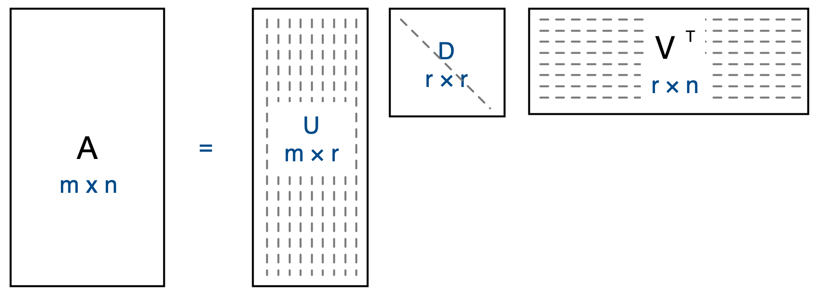
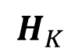
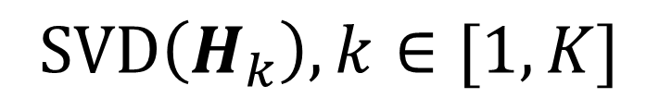
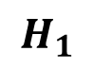


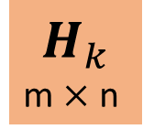


$$H$$
$$H_{1}$$
$$SVD\left(H_{k}\right), k∈[1,K]$$
$$⋱$$
$$H_{k}$$
Precoders
rows (Rx antenna)
$$⋱$$
$$H_{K}$$
columns (Tx antenna)
$$H_{k}$$
m $×$ n
Sub-channels
Power Iteration (PI)
Combiners
“Norm”

Slide 17

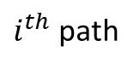
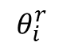
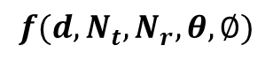
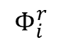
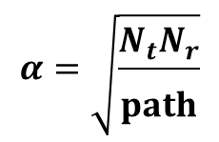
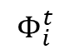
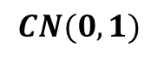
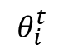
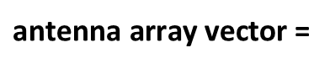
$$θ_{i}^{r}$$
Tx0
Rx0
Transmitter
$$θ_{i}^{t}$$
$$Φ_{i}^{r}$$
Receiver
$i^{th}$ path
$$Φ_{i}^{t}$$
RxNr
TxNt
$$H=\sum_{l=1}^{path}{α\text{(}\text{gain} \text{of} \text{path})×(\text{receive} \text{antenna} \text{array} \text{vectors})×(\text{transmit} \text{antenna} \text{array} \text{vectors})}$$
Channel Model
$$CN(0,1)$$
$$α=\sqrt{\frac{N_{t}N_{r}}{\begin{aligned} \\ path\end{aligned}}}$$
$\text{antenna} \text{array} \text{vector}$ =
$$f(d,N_{t},N_{r},θ,∅)$$
Inter antenna spacing

Slide 18
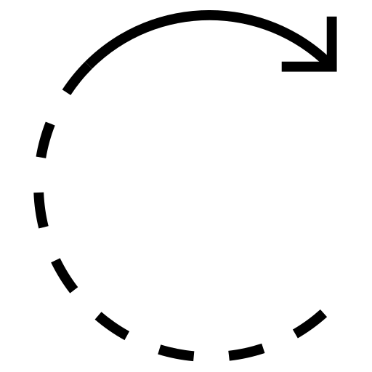

Rate
2
A
Sum Rate = log ( )
2
2
B + C
A = Combiner Desired Subchannel Precoder Desired Signal
B = Combiner Interference Subchannel Precoder Interference Signal
C = Noise power
Tx0
Rx0
Transmitter
Receiver
Tx1
Rx1

Slide 19
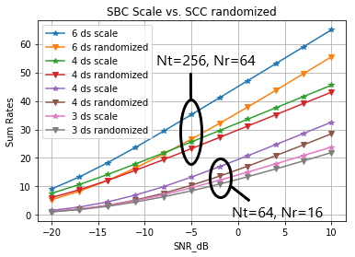
Graph Coloring
# TX antenna elements = 64 - 256
# RX antenna elements = 16 - 64
# RF chains = 3 - 6
18 %

Slide 20
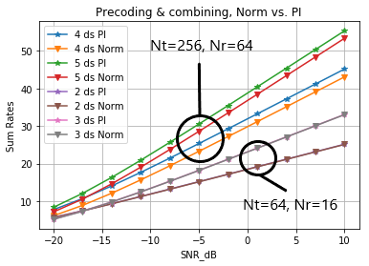
PI and Norm
# TX antenna elements = 64 - 256
# RX antenna elements = 16 - 64
# RF chains = 2 - 5

Slide 21
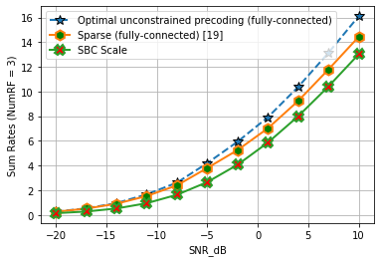
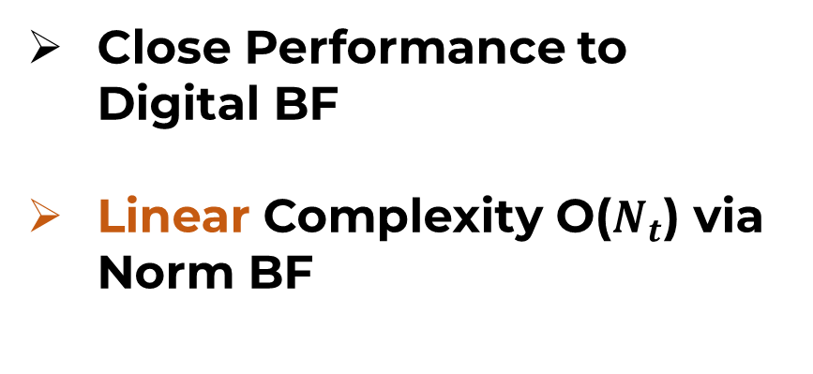
# TX antenna elements = 16
# RX antenna elements = 4
# RF chains = 3
Close Performance to Digital BF
Linear Complexity O($N_{t}$) via Norm BF
[19] O. E. Ayach, S. Rajagopal, S. Abu-Surra, Z. Pi, and R. W. Heath, “Spatially sparse precoding in millimeter wave MIMO systems,” IEEE Trans. Wireless Commun., vol. 13, no. 3, pp. 1499–1513, Mar. 2014

Slide 22
[1] A. Ghasemi and S. A. Zekavat, ”Low-Cost mmWave MIMO Multi-Streaming via Bi-Clustering, Graph Coloring, and Hybrid Beamforming,” IEEE Transactions on Wireless Communications, vol. 20, no. 7, pp. 4113-4127, July 2021, doi: 10.1109/TWC.2021.3056077.
[2] A. Ghasemi and S. R. Zekavat, ”Joint Hybrid Beamforming and Dynamic Antenna Clustering for Massive MIMO,” 29th Wireless and Optical Communications Conference (WOCC), 2020, pp. 1-6, doi: 10.1109/WOCC48579.2020.9114913. (Best Paper Award)

Slide 23


Multi-User mmWave with Imperfect CSI
Rx0
Receiver 1
Tx0
RxNr1
Transmitter
TxNt
Rx0
Receiver M
RxNrM

Slide 24


Multi-User mmWave with Imperfect CSI
Rx0
Receiver 1
Tx0
RxNr1
Transmitter
TxNt
Rx0
Receiver M
RxNrM

Slide 25





Goal
Min ($R_{perfect}−R_{imperfect}$)
Sum Rate
$R≈f(\text{Precoder},H,\text{Combiner})$
Precoder
$≈a(H)$
$≈b(H)$
Combiner

Slide 26

Robust Hybrid Beamforming [1] – [5]
Problem: only applicable
to the specific considered beamformer
Our Method:
Applicable to all beamforming types & HW-agnostic
$$H_{imperfect} \text{➔} H_{perfect}$$
[1] Alireza Morsali and Benoit Champagne. Robust hybrid analog/digital beamforming for uplink massive-mimo with imperfect csi. WCNC, 2019.
[2] Kali Krishna Kota and P. Ubaidulla. Sum-rate maximization in noma-based mmwave analog beamforming under imperfect csi. VTC2021-Spring, 2021.
[3] Deepa Jagyasi and P. Ubaidulla. Low-complexity transceiver design for multi-user millimeter wave communication systems under imperfect csi, VTC-Fall, 2016.
[4] Zhen Chen, et al.,. Robust hybrid beamforming design for multi-ris assisted mimo system with imperfect csi. IEEE Trans. Wireless Comm., 2022.
[5] Zhen Luo, et al.,. Robust hybrid transceiver design for af relaying in millimeter wave systems under imperfect csi. IEEE Access, 2018.

Slide 27

Rx0
Tx0
Transmitter
Line of Sight
Receiver 1
RxNr1
TxNt
Imperfect CSI =
Low-Rank Matrix + Noise & Error

Slide 28

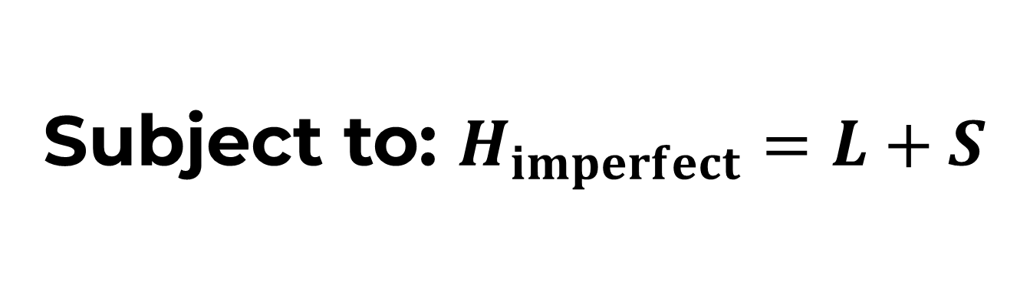



Robust PCA
Min ($R_{perfect}−R_{imperfect}$)
Min (${\left|L\right|}_{∗}+{λ\left|S\right|}_{1}$)
Subject to: $H_{imperfect}=L+S$
$$≈H_{perfect}$$
Noise & Error

Slide 29





Results
Determine $R_{imperfect}$
Apply RPCA $H_{imperfect}$ ➔ $≈H_{perfect}$
Precoder
$≈a(H_{perfect})$
$≈b(H_{perfect})$
Determine
$R_{perfect}$
Combiner
# TX antenna elements = 36
# TX antenna users = 8
# RX antenna elements = 4

Slide 30
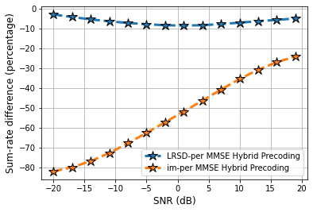
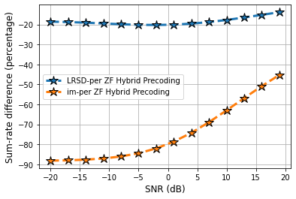
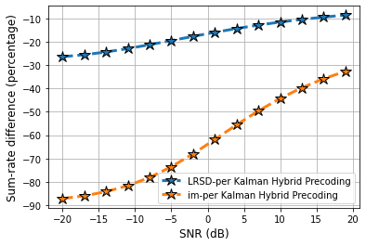
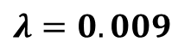
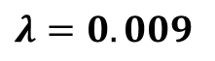
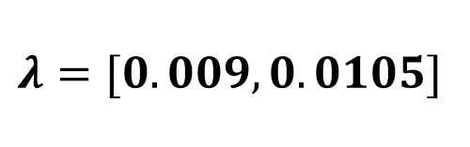
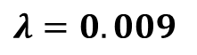
Results
$$λ=[0.009, 0.0105]$$
80 %
$$λ=0.009$$
$$λ=0.009$$
60 %
70 %
$$λ=0.009$$

Slide 31



Results
$$λ=[0.007, 0.0105]$$
80 %
$$λ=0.007$$

Slide 32

Eigenvalue Distribution Analysis

Slide 33



Eigenvalue Distribution Analysis
$$H$$
m $×$ n
SVD ($H_{imperfect}$)
SVD ($H_{perfect}$)

Slide 34



Eigenvalue Distribution Analysis
$$<D_{critical}$$
One-Sample Kolmogorov-
Smirnov (KS) Test

Slide 35

# TX antenna elements = 36
# TX antenna users = 8
# RX antenna elements = 4
# generated eigenvalues = 1600
$D_{critical}$ = 0.0259
Perfect CSI: Beta Distribution
Imperfect CSI: Johnson SB Distribution

Slide 36
[1] A. Ghasemi, Majid Moradikia, and S. A. Zekavat, ”Low-rank/Sparse Channel Matrix Decomposition-Aided
Sum-Rate Maximization in mmWave Communication Relying on Imperfect CSI,” IEEE Wireless Communications Letters (in under 2nd round of review).
[2] A. Ghasemi and S. R. Zekavat, "On Eigenvalue Distribution of Imperfect CSI in mmWave Communications," 2022 IEEE USNC-URSI Radio Science Meeting (Joint with AP-S Symposium), Denver, CO, USA, 2022, pp. 56-57, doi: 10.23919/USNC-URSI52669.2022.9887493. (Travel Award)

Slide 37




Secure GNNs based Resource Management

Slide 38


Secure GNNs based Resource Management
Rx0
Rx0
Edges
Transmitter 1
Receiver 1
TxNr1
RxNr1
Rx0
Rx0
Transmitter 2
Receiver 2
TxNr2
RxNr2

Slide 39
Adversarial Attacks in Wireless Communications [1] – [4]
Problem: Not focused on graph-structured models and data
Adversarial Attacks Against Graph-Structured Data [5] – [7]
Problem: Not within the domain of wireless communications
Our Work: First Adversarial Attack Against GNN based P2P resource management
[1] M. Sadeghi, et al., “Physical adversarial attacks against end-to-end autoencoder communication systems,” IEEE Comm. Letters, vol. 23, no. 5, pp. 847–850, 2019.
[2] B. Kim, et al., “Adversarial attacks against deep learning-based power control in wireless communications,” IEEE Globecom Workshops, pp. 1–6, 2021.
[3] B. Flowers, et al., “Evaluating adversarial evasion attacks in the context of wireless communications,” IEEE Trans. Information Forensics and Security, 2020.
[4] Y. Shi, et al., “Adversarial deep learning for cognitive radio security: Jamming attack and defense strategies,” ICC Workshops, pp. 1–6, 2018.
[5] H. Hussain, et al., “Structack: Structure-based adversarial attacks on graph neural networks,” 32nd ACM Conference on Hypertext and Social Media, ACM, 2021.
[6] D. Z ̈ugner and S. G ̈unnemann, “Adversarial attacks on graph neural networks via meta learning,” arXiv preprint arXiv:1902.08412, 2019.
[7] D. Z ̈ugner, et al., “Adversarial attacks on graph neural networks: Perturbations and their patterns,” ACM Trans. Knowledge Discovery from Data (TKDD), 2020.

Slide 40
Secure GNNs based Resource Management
Rx0
Rx0
Edges
Transmitter 1
Receiver 1
TxNr1
RxNr1
Rx0
Rx0
Vertices
Transmitter 2
Receiver 2
TxNr2
RxNr2

Slide 41


$$N$$
Vertex Feature: Desired Channel Information
Edge Feature: Interference
Channel Information
Central Processing
Unit (CPU)

Slide 42


Input: Channel Information
Rx0
Output: Precoding
Rx0
Transmitter 1
Receiver 1
TxNr1
RxNr1
Rx0
Rx0
$$N$$
Transmitter 2
Receiver 2
TxNr2
RxNr2
CPU
TRAIN

Slide 43


Input: Channel Information
Rx0
Output: Precoding
Rx0
Transmitter 1
Receiver 1
TxNr1
RxNr1
Rx0
Rx0
$$N$$
Transmitter 2
Receiver 2
TxNr2
RxNr2
TEST
CPU
Perturbation
Adversary
Adversarial Attack
Adversary – CPU channel: Fixed and Doesn’t change

Slide 44

Perturbed Feature = Feature + Perturbation
Rx0
Rx0
Power Bounded
($B_{p}$)
Transmitter 1
Receiver 1
TxNr1
Vertex Attack
RxNr1
Edge Attack
Rx0
Rx0
Transmitter 2
Receiver 2
TxNr2
RxNr2

Slide 45
Results
# Training samples = 10000
# Testing samples = 2000
# TX antenna elements = 2
SNR = 10 dB
Evaluation metric = % of Decrease in Sum Rate

Slide 46



Results
# Transceiver pairs = 20
95%
6%
Edge Attack
$B_{p}$ Edge Attack

Slide 47
Results
# Transceiver pairs = 20 - 50
N
Sum Rate

Slide 48





Eigenvalue Distribution Analysis
$B_{c}$ Edge
$B_{c}$ Vertex
$B_{p}$ Edge
$B_{p}$ Vertex

Slide 49



Eigenvalue Distribution Analysis
One-Sample Kolmogorov-
Smirnov (KS) Test
$$H$$
m $×$ n
SVD ($H_{before}$)
SVD ($H_{after}$)

Slide 50

Eigenvalue Distribution Analysis
# Transceiver pairs = 40
# Generated Network = 25
# generated eigenvalues = 1000
$D_{critical}$ = 0.0327
Before Attack: Johnson SU Distribution
After Attack: Noncentral Student’s t Distribution

Slide 51
A. Ghasemi, E. Zeraatkar, M. Moradikia, and S. A. Zekavat, ”Adversarial Attacks on Graph Neural Networks based Spatial Resource Management in P2P Wireless Communications,” IEEE Transactions on Vehicular Technology, (in the 2nd round of review).

Slide 52

Secure MS-RIS-Aided Communications

Slide 53

Secure MS-RIS-Aided Communications
Tx0
Rx0
Transmitter
Receiver
TxNt
RxNr

Slide 54


Secure MS-RIS-Aided Communications
Multi-Sector RIS
Rx0
Receiver
RxNr
Tx0
Rx0
Transmitter
Receiver
TxNt
RxNr

Slide 55
Multi-Sector RIS [1], [2]
Problem: No Security Evaluation
Single Sector IRS with Security Evaluation [3], [4]
Our Work: First Security Evaluation in Multi-Sector RIS-based Wireless Communications
[1] H. Li, et. Al., “Beyond diagonal reconfigurable intelligent surfaces: A multi-sector mode enabling highly directional full-space wireless coverage,” 2023.
[2] S. Shen, et al., “Modeling and architecture design of reconfigurable intelligent surfaces using scattering parameter network analysis,” IEEE Transactions on Wireless Communications, vol. 21, no. 2, pp. 1229–1243, 2022.
[3] Y. Omid, et al., "Deep Reinforcement Learning-Based Secure Standalone Intelligent Reflecting Surface Operation." GLOBECOM, 2022.
[4] H. Yang, et al. "Deep reinforcement learning-based intelligent reflecting surface for secure wireless communications." IEEE Trans Wireless Comm., 2020.

Slide 56

Goal
Max (Sum Secrecy Rate)
BF @ TX & MS-RIS
Sum Secrecy Rate = Secrecy Rate
Sectors
Users
Secrecy Rate = User Rate – Eavesdropper Rate
Z = Max (0, Z)

Slide 57




Approach
BF @ TX with Fixed BF @ MS-RIS
BF @ MS-RIS with Fixed BF @ TX

Slide 58

Fractional Programming

Slide 59



Fractional Programming
A
Lagrangian Dual Transform
Secrecy Rate = log ( )
2
B
A
Secrecy Rate = log ( 1 + ) - + ( 1 + )
2
B
Quadratic Transform
2
Secrecy Rate = log ( 1 + ) - + 2 ( 1 + ) Re{ A} + | | B
2
BF @ TX with Fixed BF @ MS-RIS
Block Coordinate Descent

Slide 60

Deep Reinforcement Learning

Slide 61

Deep Reinforcement Learning
Action
Agent
Environment
Reward

Slide 62
Deep Reinforcement Learning
Environment
Rx0
Receiver
RxNr
BF @ TX & MS-RIS
Rx0
Action
Receiver
RxNr
Agent
Reward
TX
Secrecy Rate

Slide 63
Results
# Epoch = 20000
# Iterations = 5000
# sectors = 2, 3, 5
# sector elements = 24
# Legitimate user in each sector = 2
# Eavesdropper in each sector = 2
TX power = 60 – 90 dBm

Slide 64
Results
# Epoch = 20000
# Iterations = 5000
# sectors = 2, 3, 5
# sector elements = 24 - 48
# Legitimate user in each sector = 2
# Eavesdropper in each sector = 2
TX power = 90 dBm

Slide 65
A. Ghasemi, A. Mosavi, M. Moradikia, and S. A. Zekavat, ”Hybrid FP and DRL Approach to Secure Beyond Diagonal RIS-Aided Communications,” will be submitted to IEEE Transactions on Vehicular Technology.

Slide 66
Contributions
Hybrid BF close Performance to Digital BF with Linear Complexity
Imperfect CSI, Robust PCA ➔ 80% in Low SNR Regimes
P2P communications, Adversarial Attacks ➔ 95%
Eigenvalue Distribution Analysis, Channel estimation status & attacks
Hybrid Approach by Merging FP and DRL

Slide 67

Publications
[1] A. Ghasemi, Majid Moradikia, and S. A. Zekavat, ”Low-rank/Sparse Channel Matrix Decomposition-Aided Sum-Rate Maximization in mmWave Communication Relying on Imperfect CSI,” Submitted to IEEE Wireless Communications Letters.
[2] A. Ghasemi, E. Zeraatkar, M. Moradikia, and S. A. Zekavat, ”Adversarial Attacks on Graph Neural Networks based Spatial Resource Management in P2P Wireless Communications,” IEEE Transactions on Vehicular Technology, (in the 2nd round of review).
[3] A. Ghasemi and S. A. Zekavat, ”Low-Cost mmWave MIMO Multi-Streaming via Bi-Clustering, Graph Coloring, and Hybrid Beamforming,” IEEE Transactions on Wireless Communications, vol. 20, no. 7, pp. 4113-4127, July 2021, doi: 10.1109/TWC.2021.3056077.
[4] A. Ghasemi and S. R. Zekavat, ”Joint Hybrid Beamforming and Dynamic Antenna Clustering for Massive MIMO,” 29th Wireless and Optical Communications Conference (WOCC), 2020, pp. 1-6, doi: 10.1109/WOCC48579.2020.9114913. (Best Paper Award)
[5] A. Ghasemi, A. Mosavi, M. Moradikia, and S. A. Zekavat, ”Hybrid FP and DRL Approach to Secure Beyond Diagonal RIS-Aided Communications,” will be submitted to IEEE Transactions on Vehicular Technology.
[6] A. Ghasemi and S. R. Zekavat, "On Eigenvalue Distribution of Imperfect CSI in mmWave Communications," 2022 IEEE USNC-URSI Radio Science Meeting (Joint with AP-S Symposium), Denver, CO, USA, 2022, pp. 56-57, doi: 10.23919/USNC-URSI52669.2022.9887493. (Travel Award)
[7] S. Zekavat, R. M. Buehrer, G. D. Durgin, L. Lovisolo, Z. Wang, S. T. Goh, and A. Ghasemi, ”An Overview on Position Location: Past, Present, Future,” Int J Wireless Inf Networks 28, 45–76, 2021. https://doi.org/10.1007/s10776-021-00504-z

Slide 68

Have a HUGE Secrecy Rate!

